Slide 1




My Algebra Interactive Notebook
$$3ab$$
$$2x+3y$$
$$\frac{5xy}{6}$$
Name :
Class : Mrs Keen
Term 2 Semester 1
$$y=2x+1$$

Slide 2
Contents
Glossary
Page
Date
Description
2
3

Slide 3
Tasks
24
7
30
Essential Question
Questions
Notes
Summary
4
5

Slide 4
24
7
30
Date
Fractions
EQ – What do you do when you multiply or divide fractions?
5

Slide 5
24
7
30
Date
Fractions
EQ – What do you do when you multiply or divide fractions?
How do you multiply fractions?
5

Slide 6
24
7
30
Date
Fractions
EQ – What do you do when you multiply or divide fractions?
How do you multiply fractions?
First you simplify, then you multiply the numerators together and then the denominators together.
What does simplify mean?
5

Slide 7
24
7
30
Date
Fractions
EQ – What do you do when you multiply or divide fractions?
How do you multiply fractions?
First you simplify, then you multiply the numerators together and then the denominators together.
What does simplify mean?
Don’t forget to simplify. If you can, do this first. It makes multiplying much easier.
5

Slide 8

24
7
30
Date
Fractions
EQ – What do you do when you multiply or divide fractions?
How do you multiply fractions?
First you simplify, then you multiply the numerators together and then the denominators together.
What does simplify mean?
Don’t forget to simplify. If you can, do this first. It makes multiplying much easier.
1
÷2
e.g. $\frac{3}{5} × \frac{2}{4} = \frac{3×1}{5×2}= \frac{3}{10}$
2
÷2
5

Slide 9
24
7
30
Date
Fractions
EQ – What do you do when you multiply or divide fractions?
How do you multiply fractions?
First you simplify, then you multiply the numerators together and then the denominators together.
What does simplify mean?
Don’t forget to simplify. If you can, do this first. It makes multiplying much easier.
1
÷2
Even if you don’t simplify first, you can still simplify the answer
e.g. $\frac{3}{5} × \frac{2}{4} = \frac{3×1}{5×2}= \frac{3}{10}$
2
÷2
5

Slide 10
24
7
30
Date
Fractions
EQ – What do you do when you multiply or divide fractions?
How do you multiply fractions?
First you simplify, then you multiply the numerators together and then the denominators together.
What does simplify mean?
Don’t forget to simplify. If you can, do this first. It makes multiplying much easier.
1
÷2
Even if you don’t simplify first, you can still simplify the answer
e.g. $\frac{3}{5} × \frac{2}{4} = \frac{3×1}{5×2}= \frac{3}{10}$
2
÷2
How do you divide fractions?
5

Slide 11
24
7
30
Date
Fractions
EQ – What do you do when you multiply or divide fractions?
How do you multiply fractions?
First you simplify, then you multiply the numerators together and then the denominators together.
What does simplify mean?
Don’t forget to simplify. If you can, do this first. It makes multiplying much easier.
1
÷2
Even if you don’t simplify first, you can still simplify the answer
e.g. $\frac{3}{5} × \frac{2}{4} = \frac{3×1}{5×2}= \frac{3}{10}$
2
÷2
How do you divide fractions?
First find the reciprocal and then multiply.
5

Slide 12
24
7
30
Date
Fractions
EQ – What do you do when you multiply or divide fractions?
How do you multiply fractions?
First you simplify, then you multiply the numerators together and then the denominators together.
What does simplify mean?
Don’t forget to simplify. If you can, do this first. It makes multiplying much easier.
1
÷2
Even if you don’t simplify first, you can still simplify the answer
e.g. $\frac{3}{5} × \frac{2}{4} = \frac{3×1}{5×2}= \frac{3}{10}$
2
÷2
How do you divide fractions?
First find the reciprocal and then multiply.
What is the reciprocal?
5

Slide 13
24
7
30
Date
Fractions
EQ – What do you do when you multiply or divide fractions?
How do you multiply fractions?
First you simplify, then you multiply the numerators together and then the denominators together.
What does simplify mean?
Don’t forget to simplify. If you can, do this first. It makes multiplying much easier.
1
÷2
Even if you don’t simplify first, you can still simplify the answer
e.g. $\frac{3}{5} × \frac{2}{4} = \frac{3×1}{5×2}= \frac{3}{10}$
2
÷2
How do you divide fractions?
First find the reciprocal and then multiply.
What is the reciprocal?
A fraction multiplied by its reciprocal always equals 1.
5

Slide 14

24
7
30
Date
Fractions
EQ – What do you do when you multiply or divide fractions?
How do you multiply fractions?
First you simplify, then you multiply the numerators together and then the denominators together.
What does simplify mean?
Don’t forget to simplify. If you can, do this first. It makes multiplying much easier.
1
÷2
Even if you don’t simplify first, you can still simplify the answer
e.g. $\frac{3}{5} × \frac{2}{4} = \frac{3×1}{5×2}= \frac{3}{10}$
2
÷2
How do you divide fractions?
First find the reciprocal and then multiply.
What is the reciprocal?
A fraction multiplied by its reciprocal always equals 1.
e.g. $\frac{2}{3} × \frac{3}{2}= \frac{2×3}{3×2}= \frac{6}{6}=1$
5

Slide 15
24
7
30
Date
Fractions
EQ – What do you do when you multiply or divide fractions?
How do you multiply fractions?
First you simplify, then you multiply the numerators together and then the denominators together.
What does simplify mean?
Don’t forget to simplify. If you can, do this first. It makes multiplying much easier.
1
÷2
Even if you don’t simplify first, you can still simplify the answer
e.g. $\frac{3}{5} × \frac{2}{4} = \frac{3×1}{5×2}= \frac{3}{10}$
2
÷2
How do you divide fractions?
First find the reciprocal and then multiply.
What is the reciprocal?
A fraction multiplied by its reciprocal always equals 1.
e.g. $\frac{2}{3} × \frac{3}{2}= \frac{2×3}{3×2}= \frac{6}{6}=1$
So, the reciprocal of a fraction is the fraction flipped over.
5

Slide 16
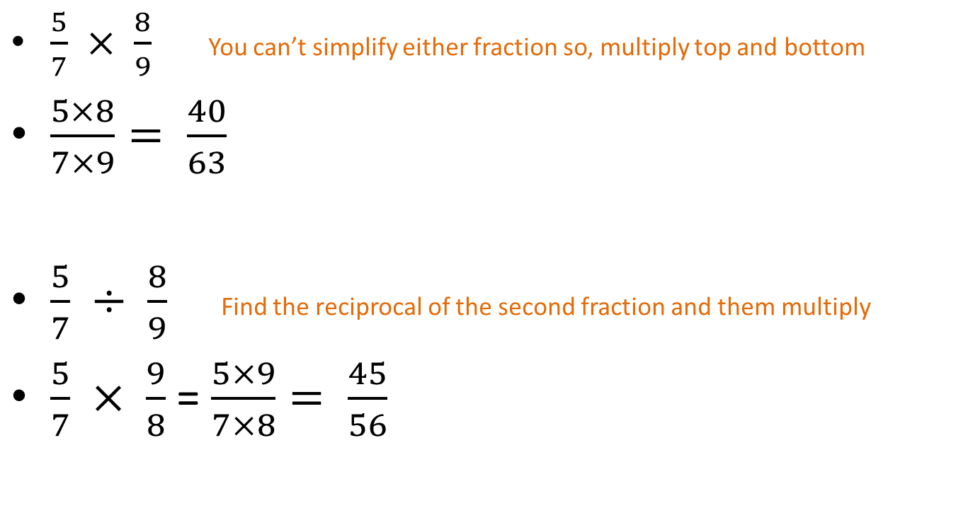
Some examples
$\frac{5}{7} × \frac{8}{9}$ You can’t simplify either fraction so, multiply top and bottom
$\frac{5×8}{7×9}= \frac{40}{63}$
$\frac{5}{7} ÷ \frac{8}{9}$ Find the reciprocal of the second fraction and them multiply
$\frac{5}{7} × \frac{9}{8}$ = $\frac{5×9}{7×8}= \frac{45}{56}$

Slide 17

Let’s try these together
$\frac{1}{3}×\frac{5}{6}$
$\frac{3}{4}×\frac{5}{10}$
$\frac{5}{6}÷\frac{3}{4}$
$\frac{2}{3}÷\frac{3}{4}$

Slide 18
Task
10
Extension: Page 116 in your text books. Try all the worded questions.

Slide 19
Remember!

Slide 20
Fill in the questions

Slide 21
Notes Review
24, 7 ,30
Date
Title
Essential question
Notes complete
Notes complete with colour and diagrams
Questions completed
Contents page filled in
Formula page filled in

Slide 22
Homework
Review your notes and write a summary answering the essential question.

